Slide 1




Digital Egypt Pioneers Initiative
CUSTOMER DATA MANAGEMENT AND ANALYSIS

Slide 2

Overview
Introduction
Problem Statement
Objectives
Database
Data Warehouse
Azure Cloud
Power BI
Q&A
03
04
05
06
12
16
19
20

Slide 3


Introduction
In today’s data-driven world, businesses are increasingly relying on customer data to make informed decisions, enhance customer experiences, and drive growth. Effective customer data management and analysis enable organizations to understand their customers better, predict trends, and tailor their services to meet customer needs. This project focuses on developing a robust system for managing and analyzing customer data to unlock valuable insights and improve business outcomes.

Slide 4

Problem Statement
Despite the availability of vast amounts of customer data, many businesses struggle with effectively managing and analyzing this information.
It becomes challenging to track customer interactions, analyze purchasing patterns, and provide personalized services.
Our project addresses this issue by developing a structured database that integrates customer, order, and product information, facilitating better data management and insightful analysis for improved business outcomes.

Slide 5






Objectives
Establish a robust SQL database for customer data management.
Design a data warehousing strategy to optimize data storage and retrieval.
Extract, transform, and load data from the ECommerceDB source database to the ECommerceDW data warehouse, converting raw data into structured Dimension and Fact tables.
Integrate Azure services for enhanced data storage and processing capabilities.
Utilize Power BI to visualize and analyze the structured data from ECommerceDW, transforming raw insights into actionable business intelligence.
Database
Data Warehouse
ETL
Azure

Slide 6




Database Description
This database is designed to effectively manage customer data, orders, and product details, facilitating comprehensive data analysis and operational efficiency. Below is a brief overview of each table:
Customer: Stores customer information.
Order: Tracks order details per customer.
Order Details: Links specific products to each order.
Employee: Manages employee data for order fulfillment.
Shipper: Handles shipping details for orders.
Product: Lists product information.
Category: Organizes products into categories.
Supplier: Tracks product suppliers.

Slide 7
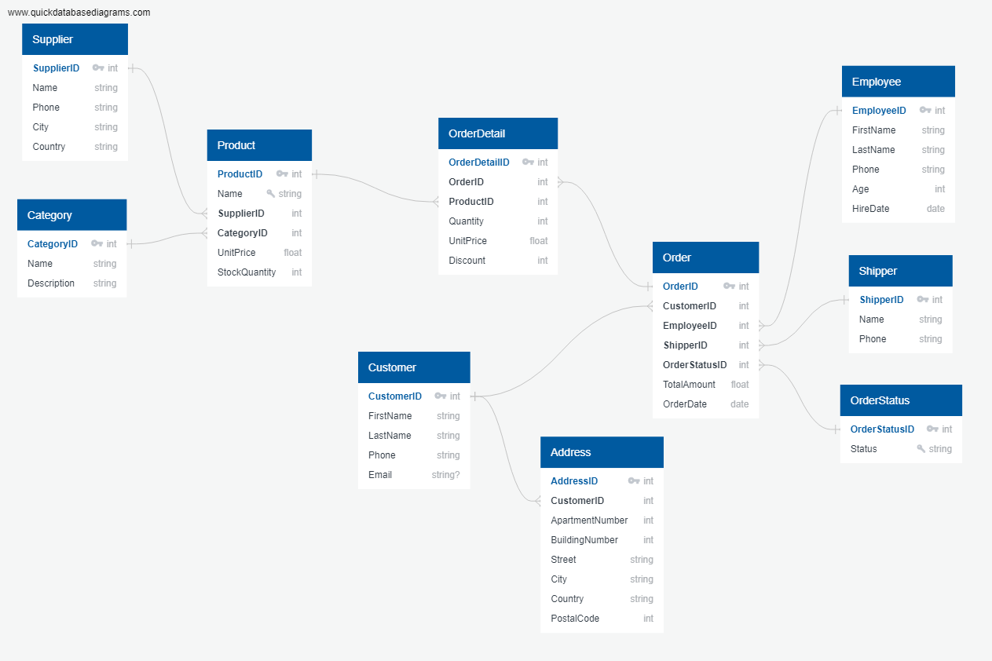
Database Schema

Slide 8




Analyzing Data Queries
Top three Total orders by each customer.
Revenue generated per category.
Analyze the average order value per customer, This can be useful to understand customer spending behavior.

Slide 9
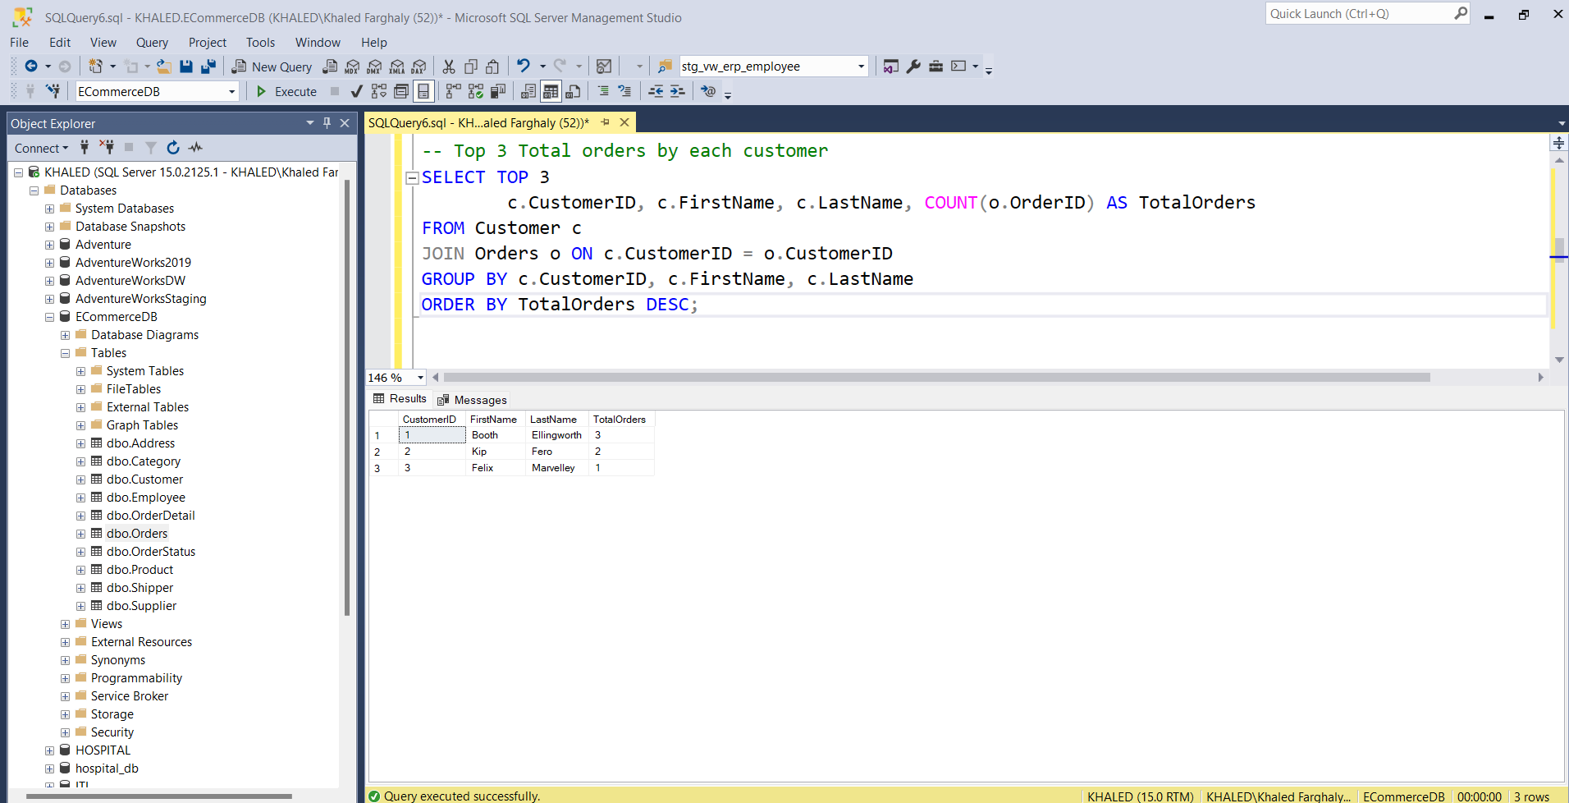
Top three Total orders by each customer

Slide 10
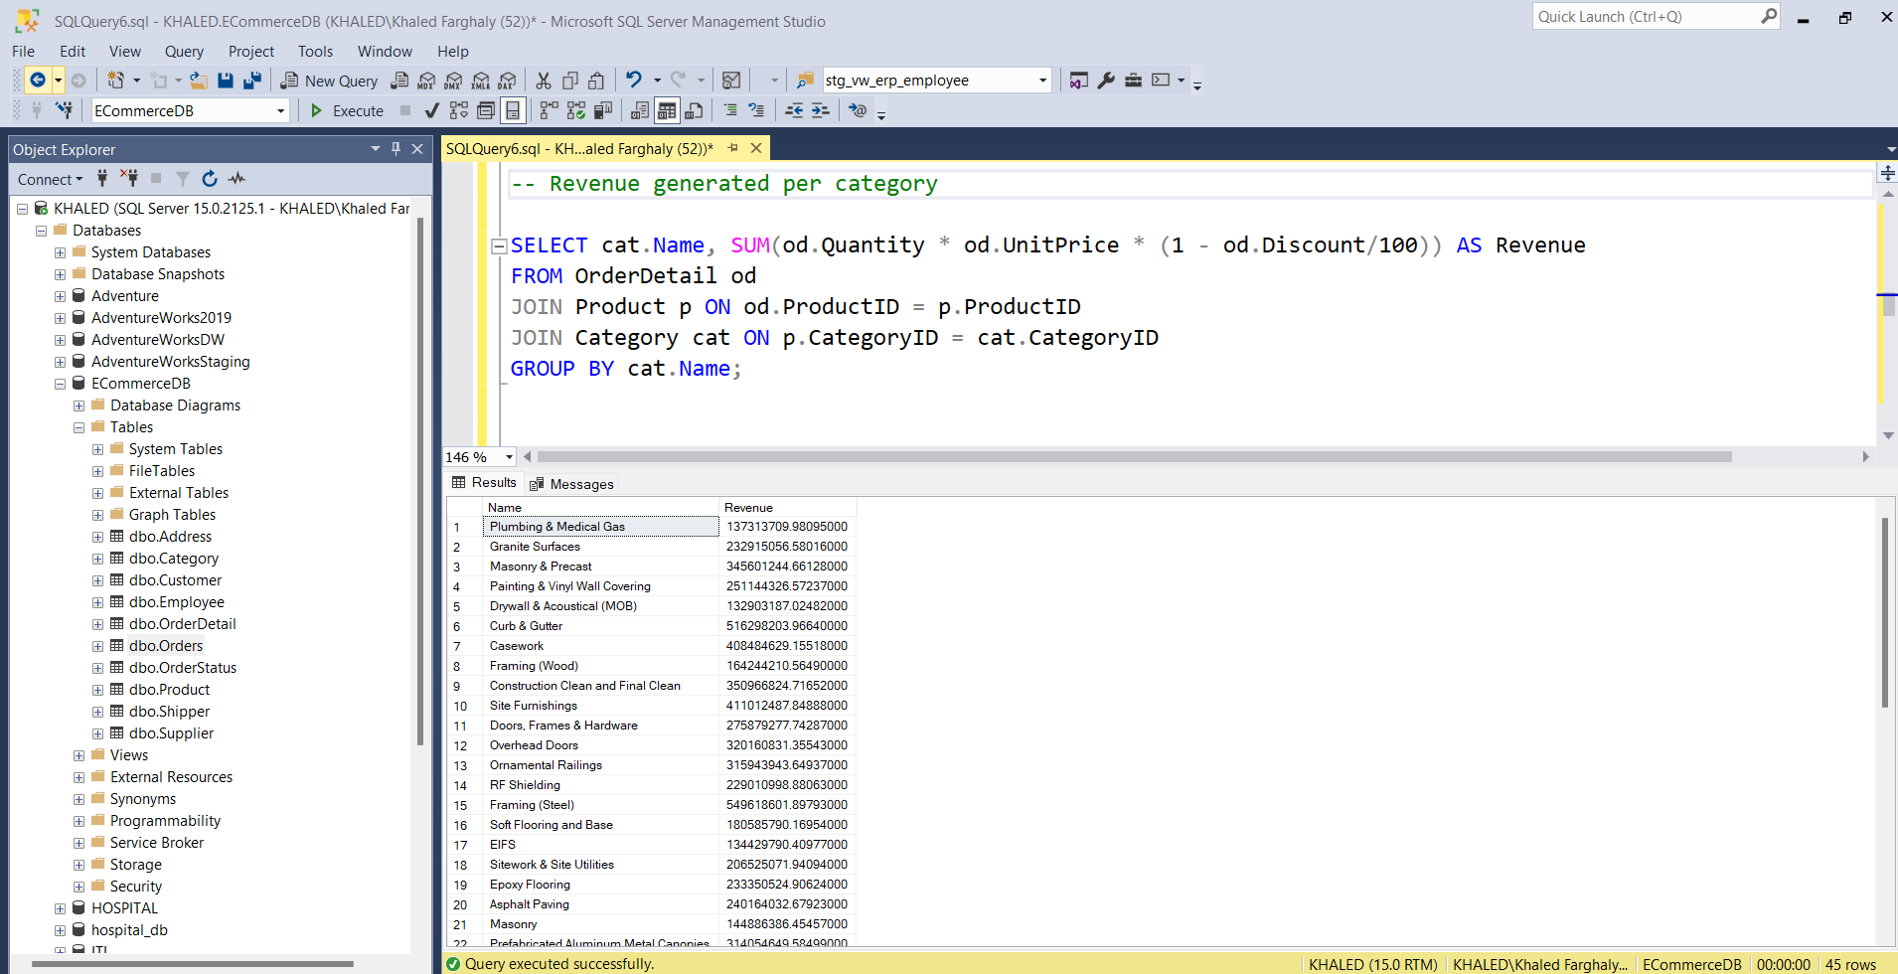
Revenue generated per category

Slide 11
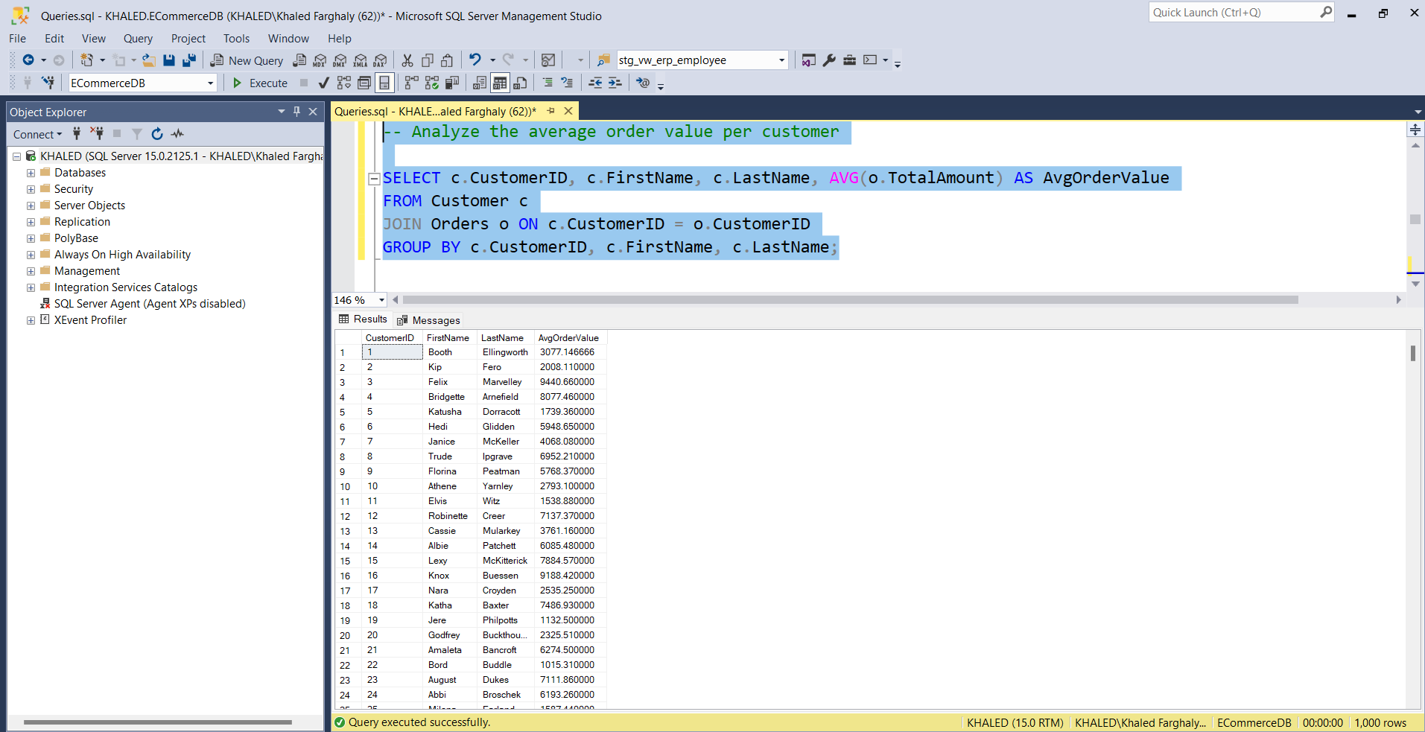
Analyze the average order value per customer

Slide 12

DATA WAREHOUSE

Slide 13



Data Warehouse Description
Star schema data warehouse design where the central fact table (FactOrdersAndDetails) is linked to several dimension tables.
FactOrdersAndDetails: This is the central table that stores transactional data, specifically orders and their details.
DimCategory: Holds information about product categories.
DimProduct: Contains details about each product.
DimSupplier: Stores supplier-related data.
DimCustomer: Contains customer information.
DimAddress: Linked to DimCustomer, this table stores customer addresses.
DimOrderStatus: Tracks the status of orders
DimEmployee: Stores information on employees who may be handling orders.
DimShipper: Contains data about the shippers who handle deliveries.

Slide 14
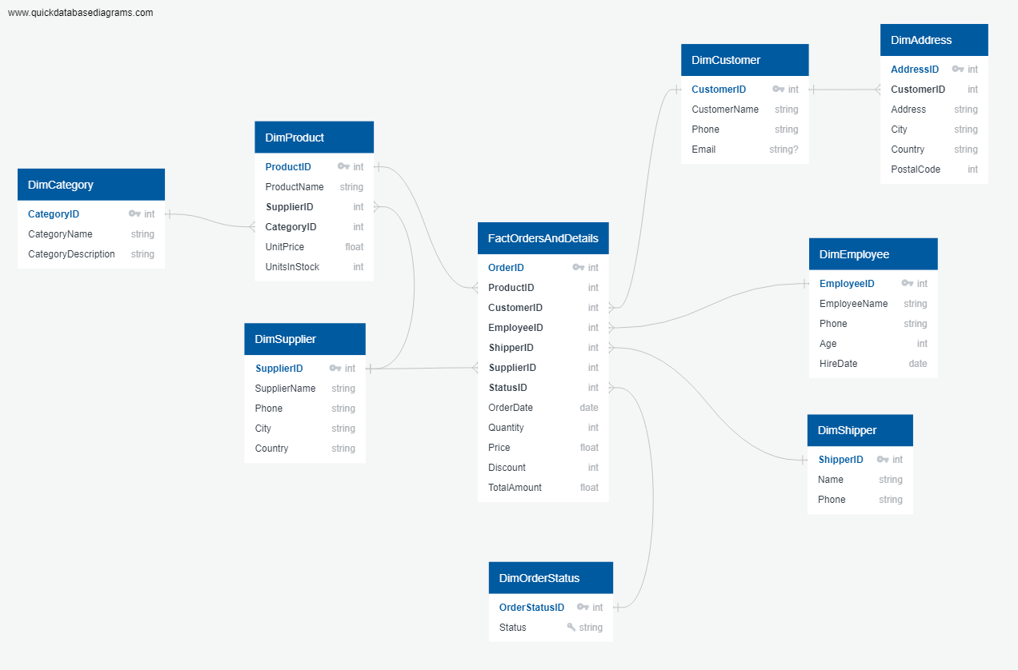
Data Warehouse
Star
Schema

Slide 15

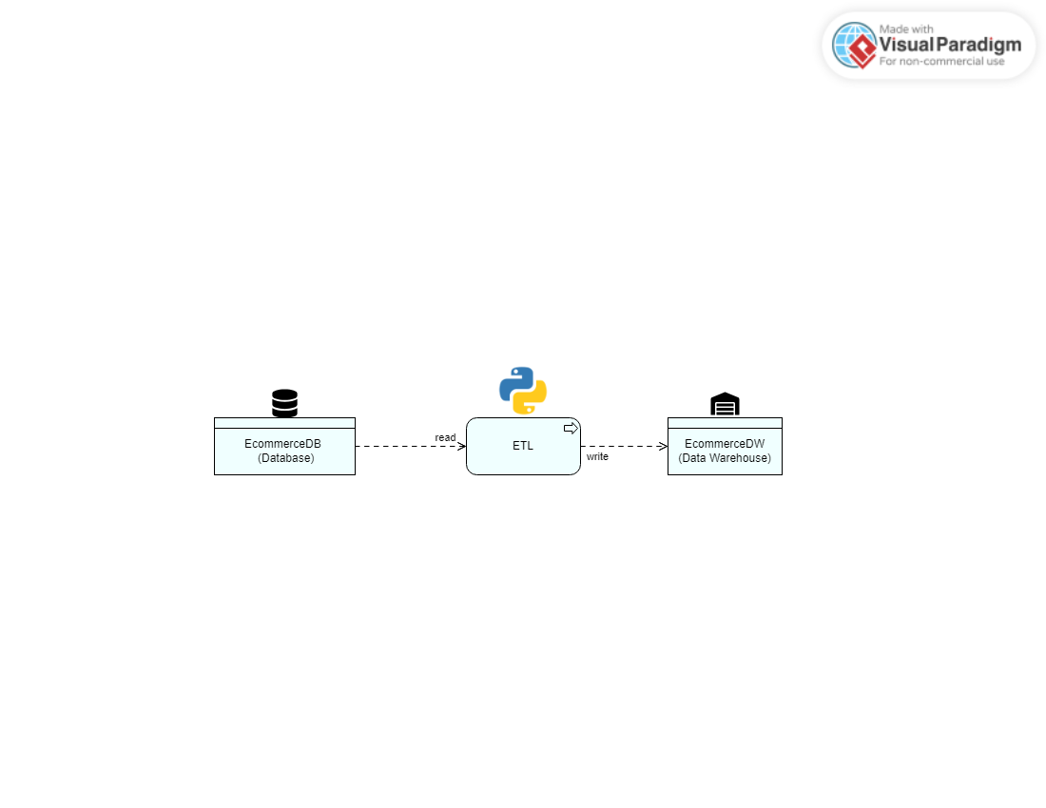
ETL
Establish source database connection (ECommerceDB) and target data warehouse connection (ECommerceDW) using SQLAlchemy.
Define source tables (Customer, Address, Employee, etc.) and load data into pandas DataFrames.
Perform data preparation and transformation (e.g., filling missing values, combining names).
Transform DataFrames to match the structure of Dimension and Fact tables.

Slide 16




Azure Cloud
Azure Cloud for scalable data storage and processing.
Azure Synapse Analytics for integrated data analytics and transformation.
Azure Synapse to efficiently store and convert CSV file data into structured tables within the data warehouse.

Slide 17
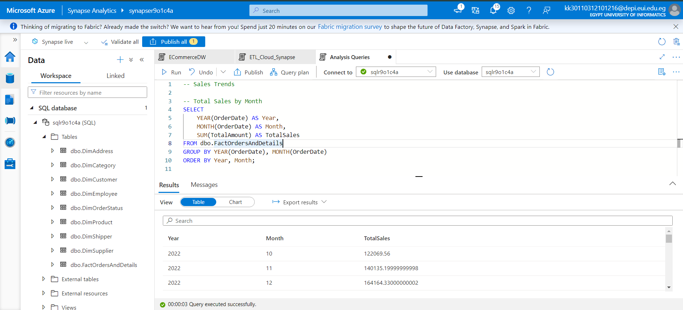
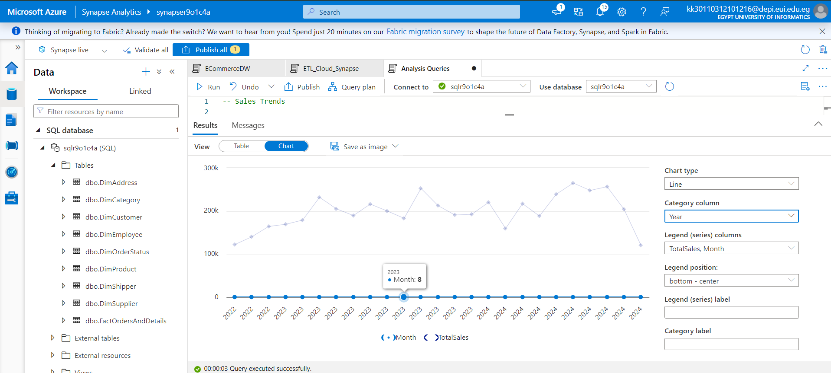
Analysis in Synapse
Total Sales by Month and Year

Slide 18
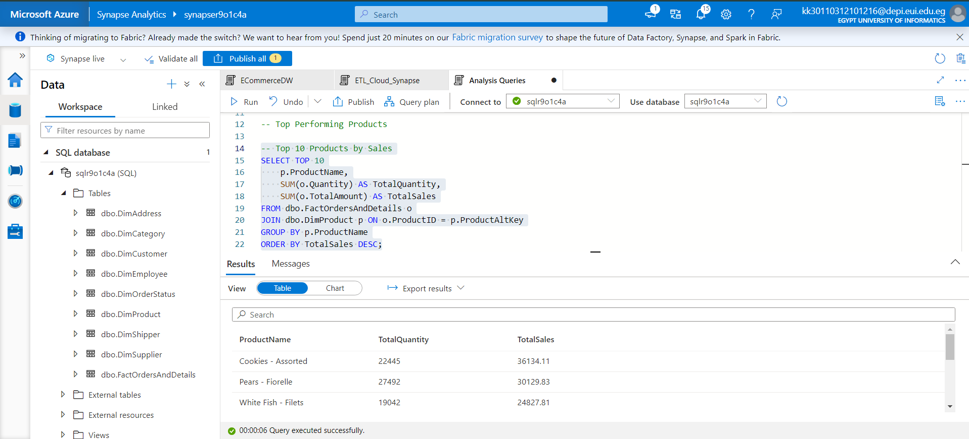
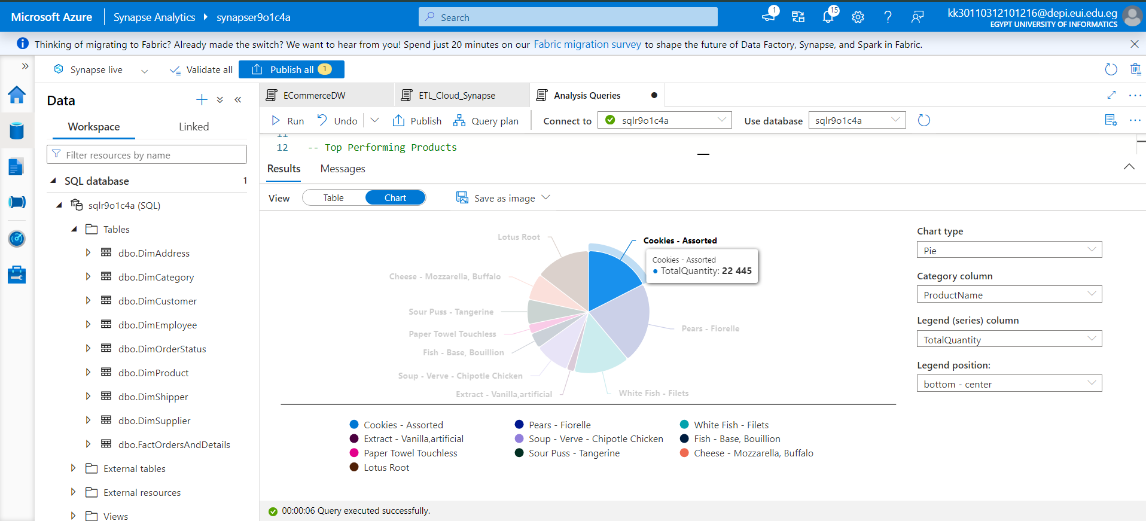
Analysis in Synapse
Top 10 Products by sales

Slide 19
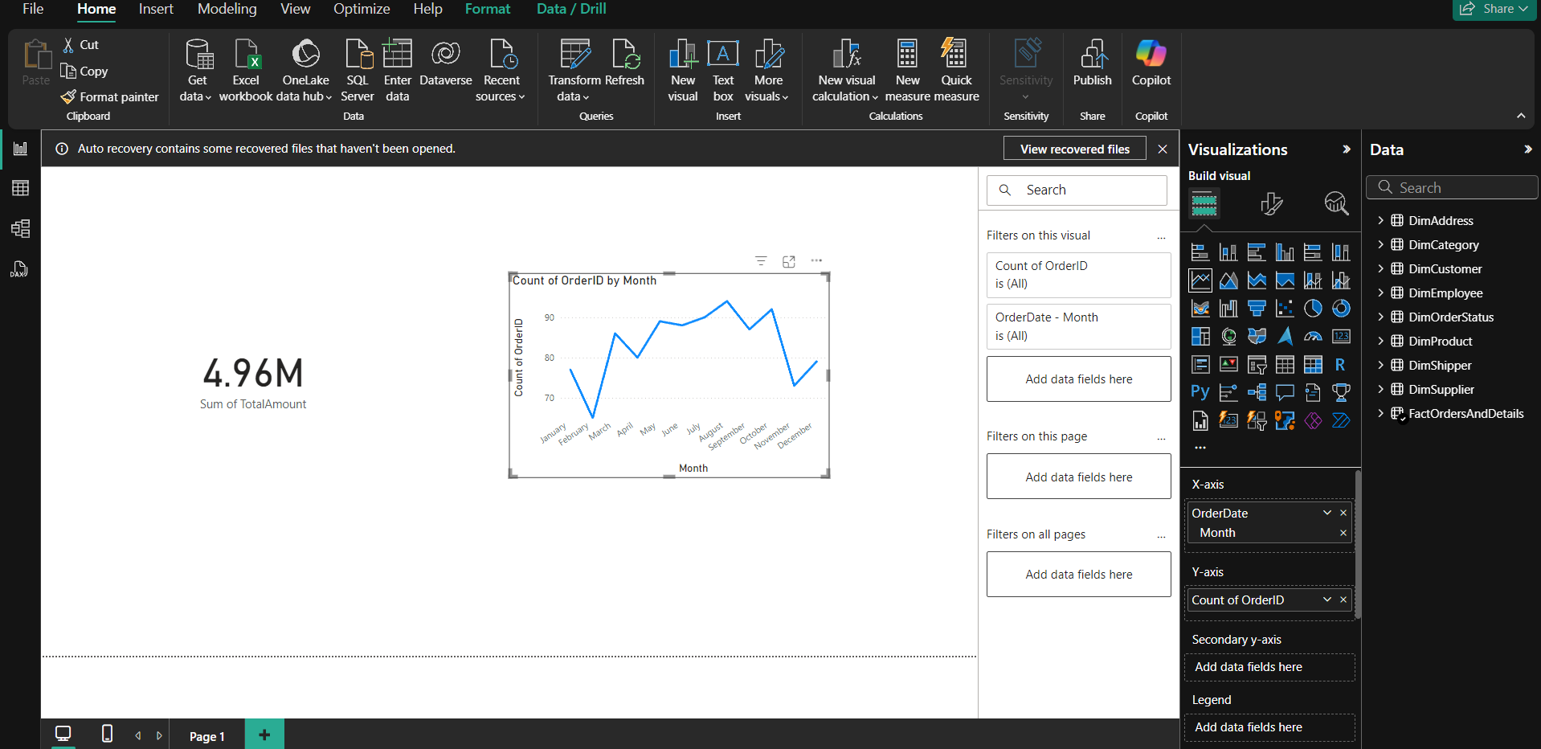
Power BI
Connected Power BI to Azure Synapse to create insightful visualizations and charts based on the data warehouse.

Slide 20

Q&A
Thank You

